Slide 2

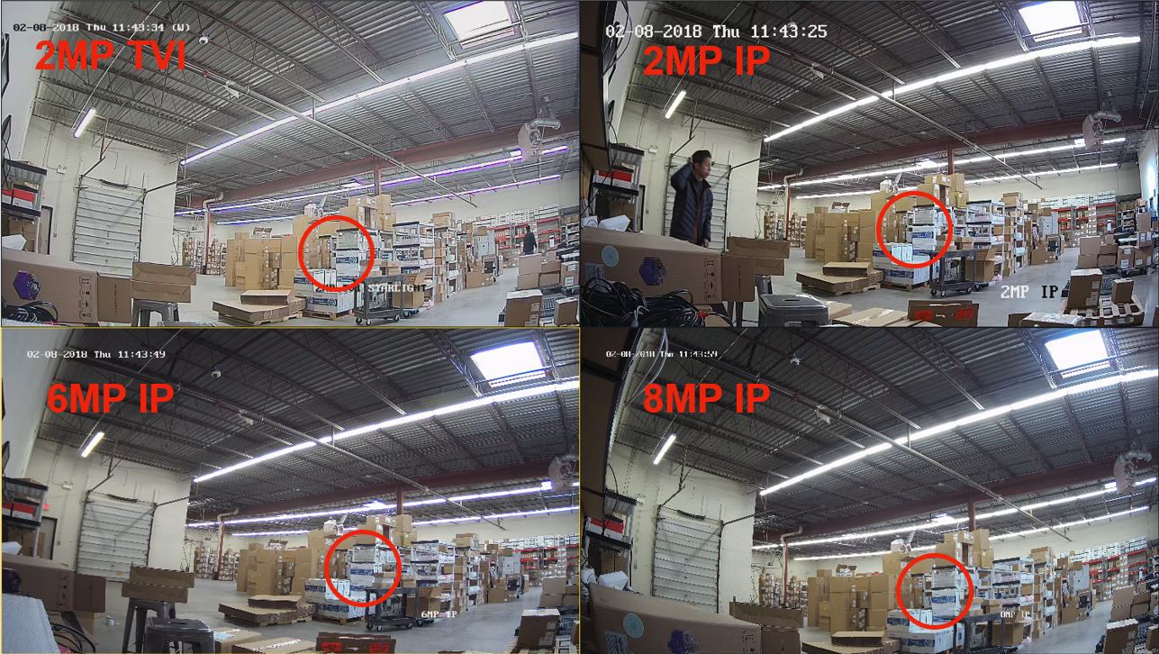
Matrix IR Turret, 30ft Away, 2.8mm lens

Slide 3
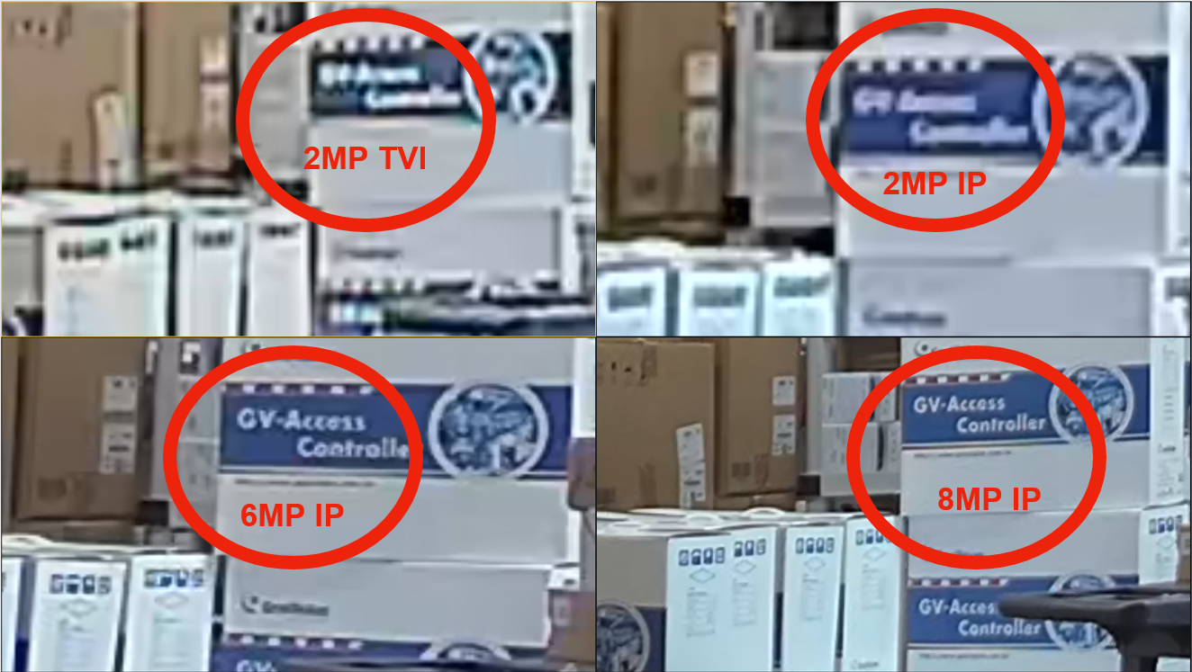
DIGITAL ZOOMED

Slide 4
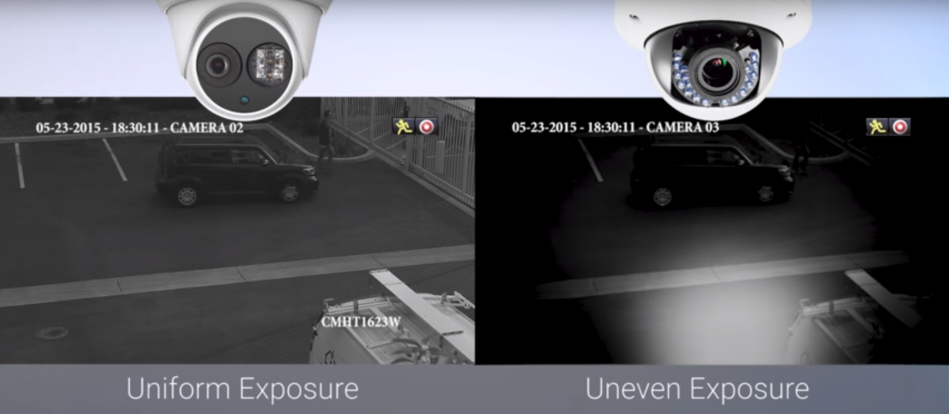
MATRIX IR: GIVING YOU THE BEST NIGHT VIDEOS!

Slide 5
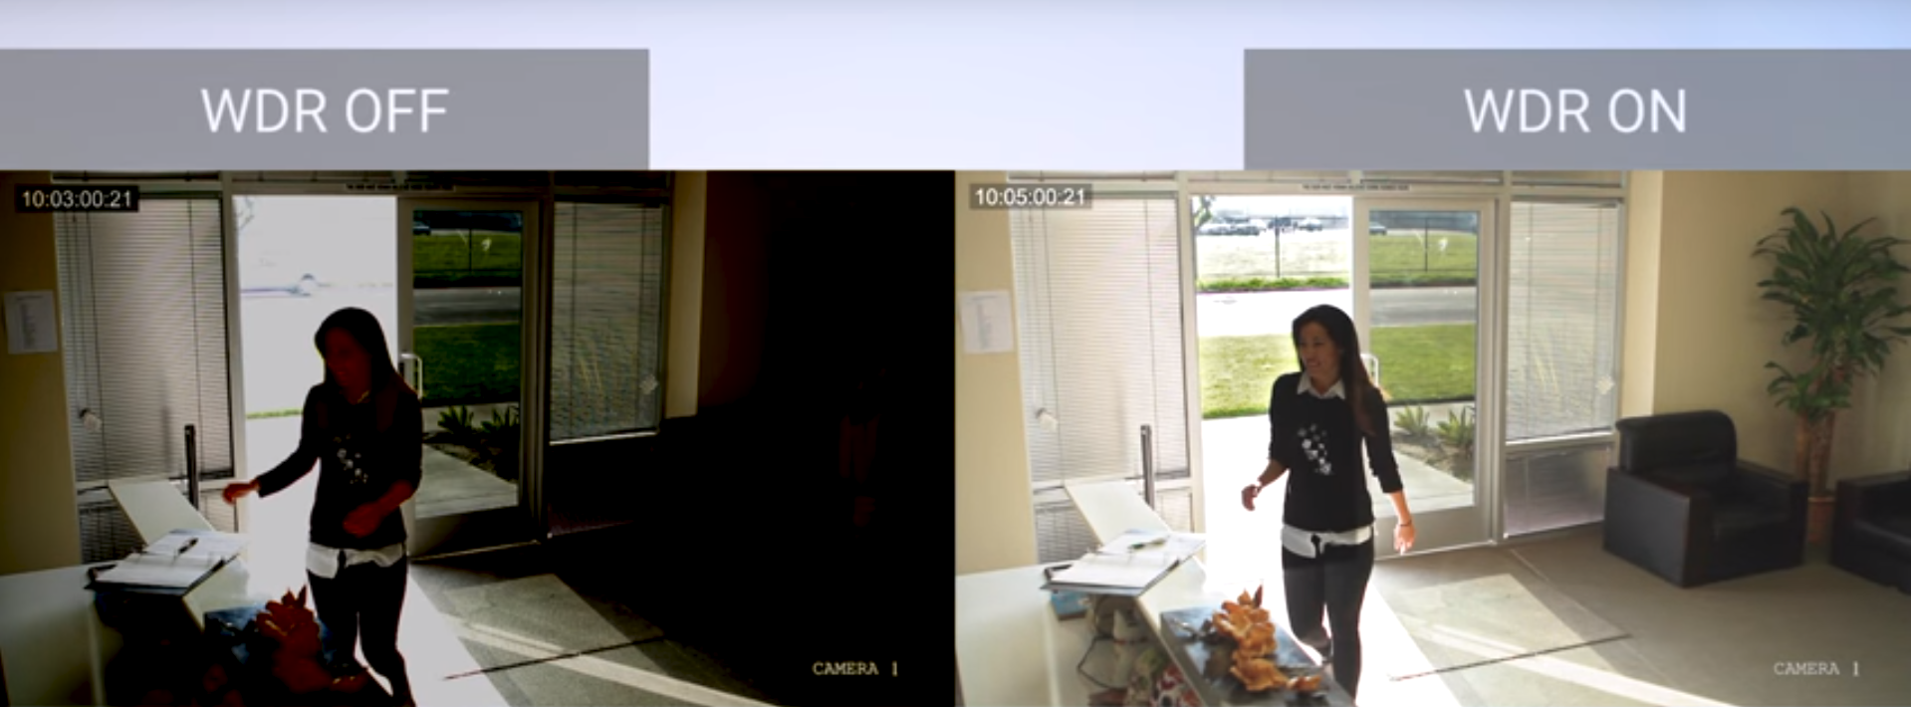
TRUE WDR: THE BEST DAYTIME VIDEOS!

Slide 6
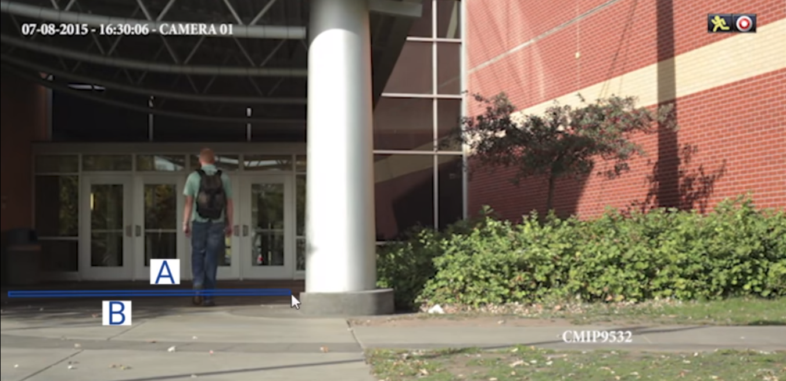
VCA (Video Content Analytics)

Slide 7
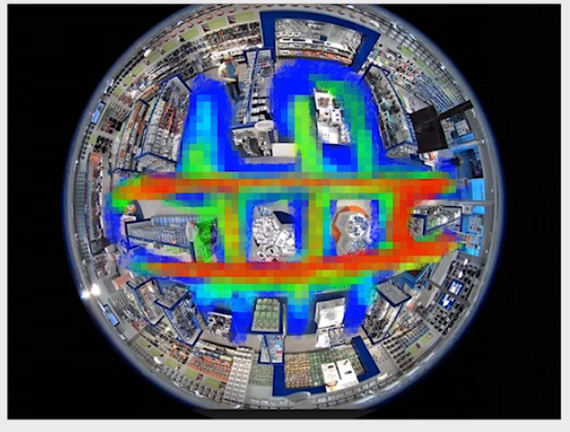
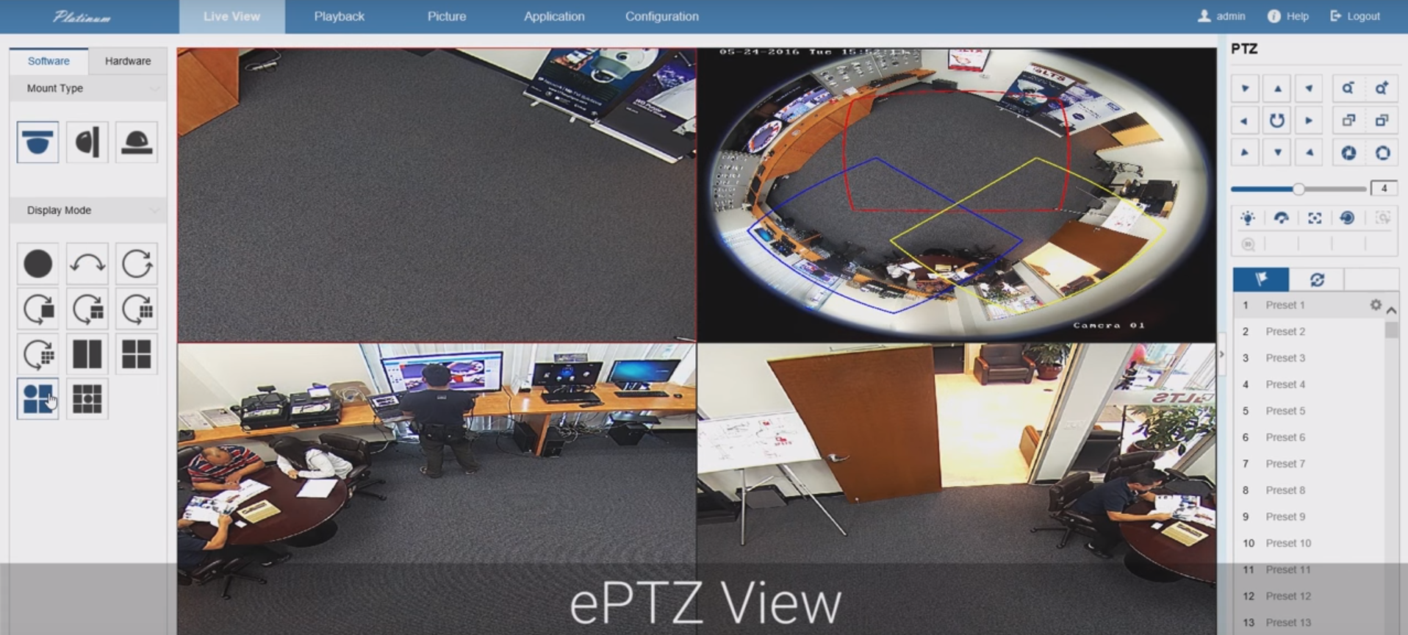
Fisheye: 360 Degrees View

Slide 8
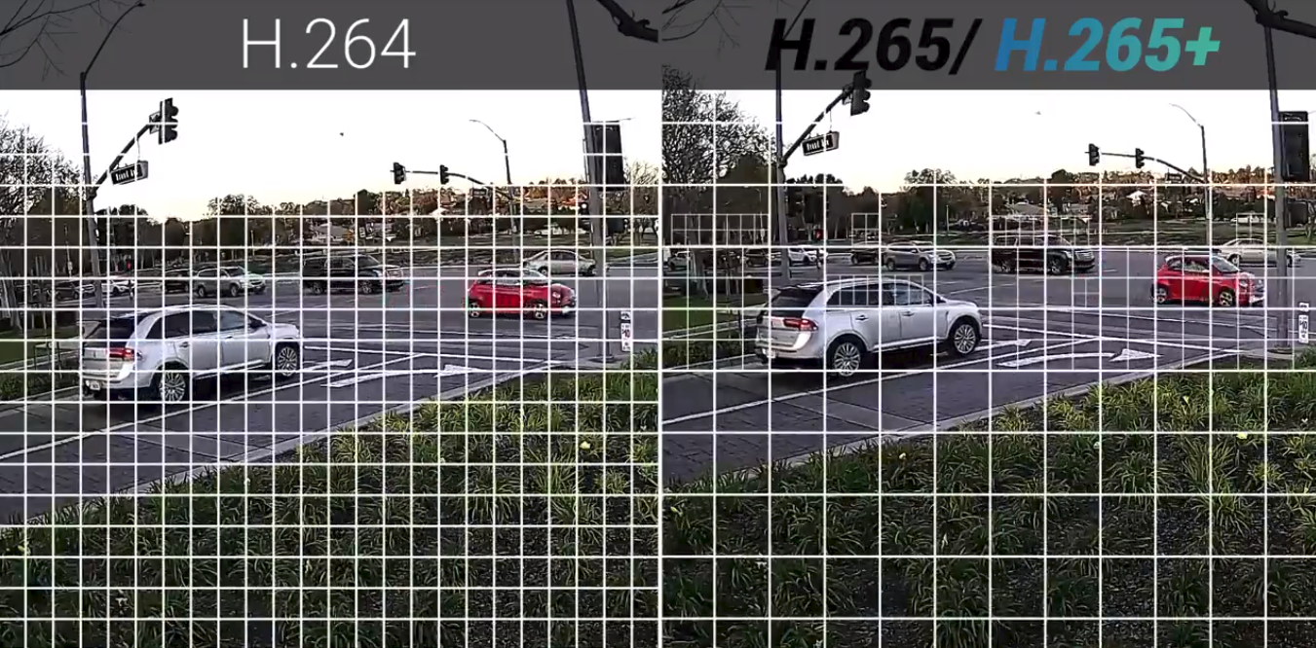
New Compression H.265+ : More Storage, Smoother Live View!

Slide 9
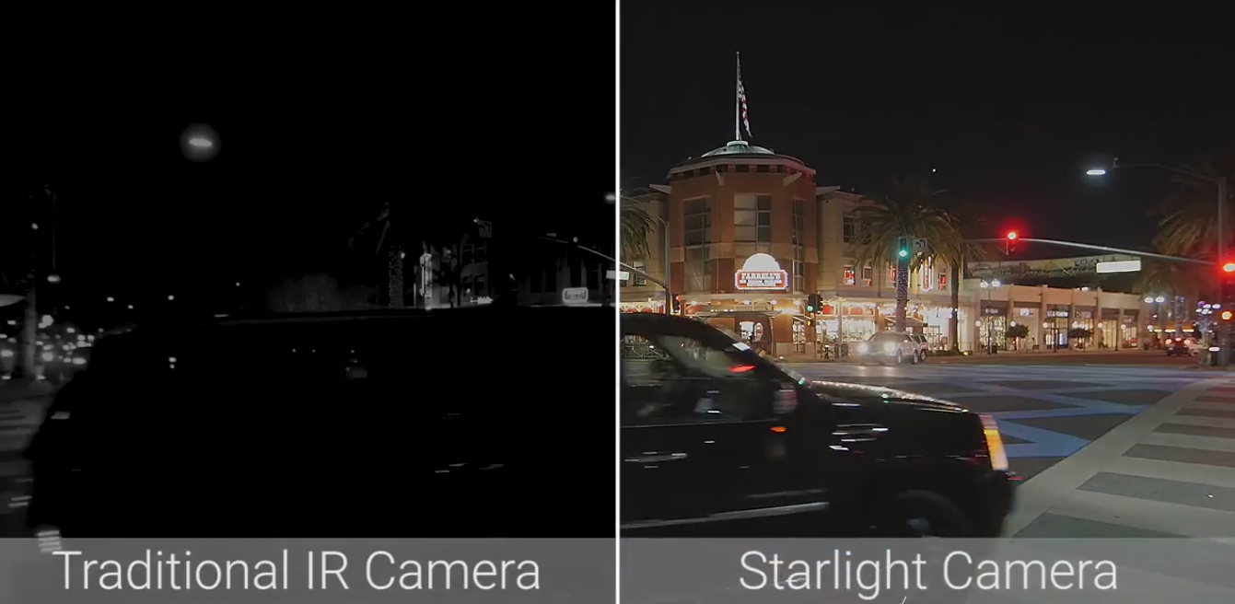
Starlight: Colored at Night!

Slide 10
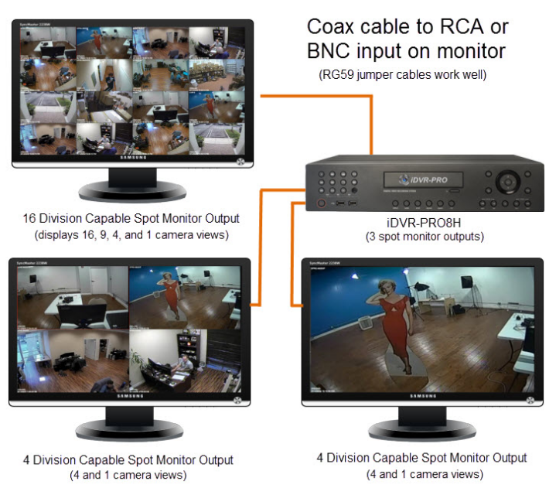
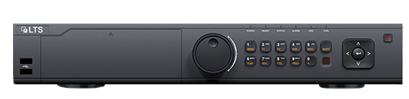
SPOT OUT MONITORS
Main Monitor
Settings, Playback, Everything
Example Location: Server Room
Spot Monitor (CVBS up to 480p)
Example Location: Front Door
LTS Network Video Recorder
Spot Monitor (VGA up to 1080p)
Example Location: At Cashier’s
*Not all models support this function.
**Pictures of the monitors are from online.

Slide 11
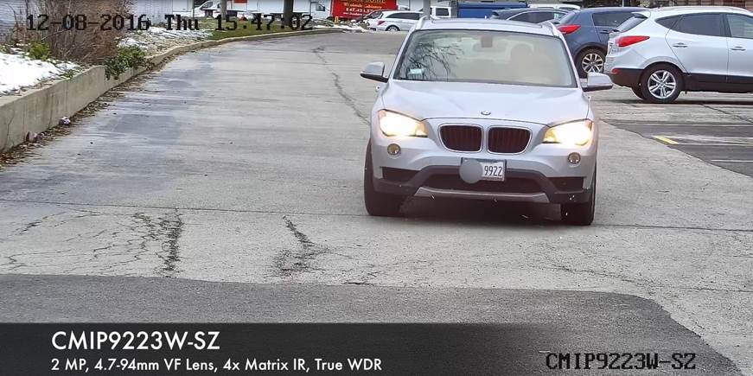
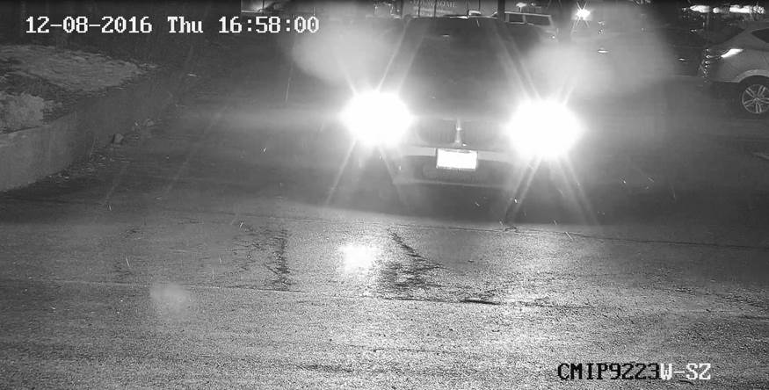
Want License Plates?

Slide 12
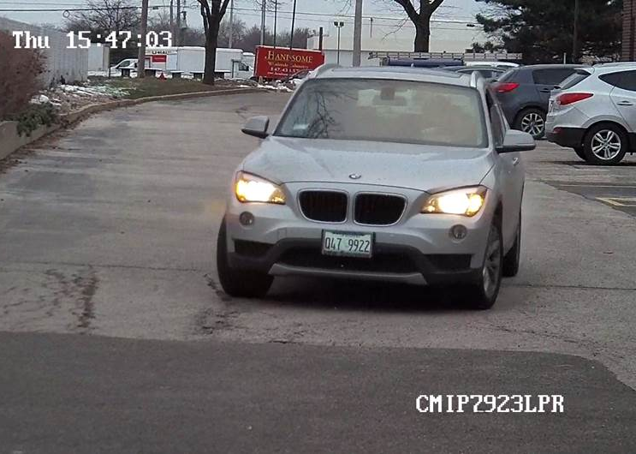
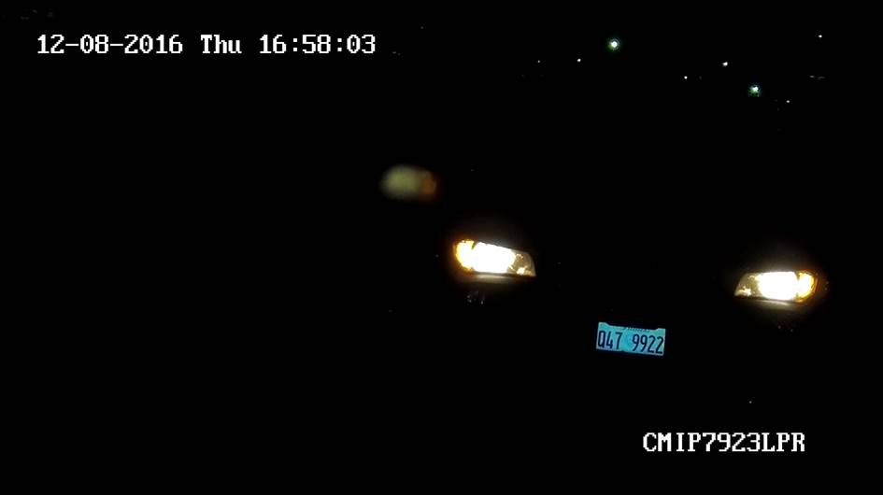
Get an LPR!

Slide 13
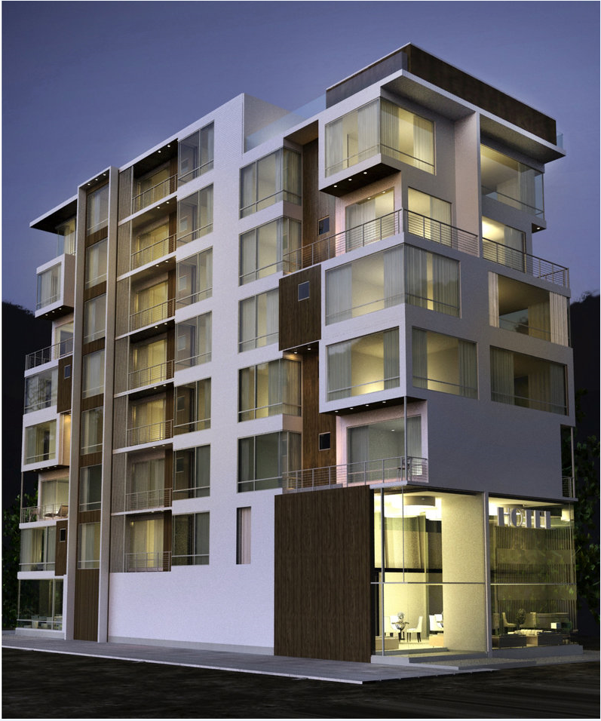
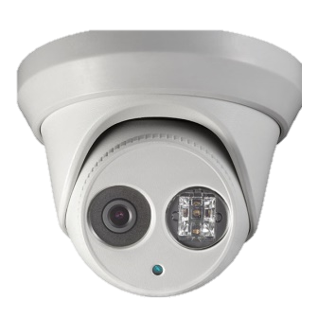
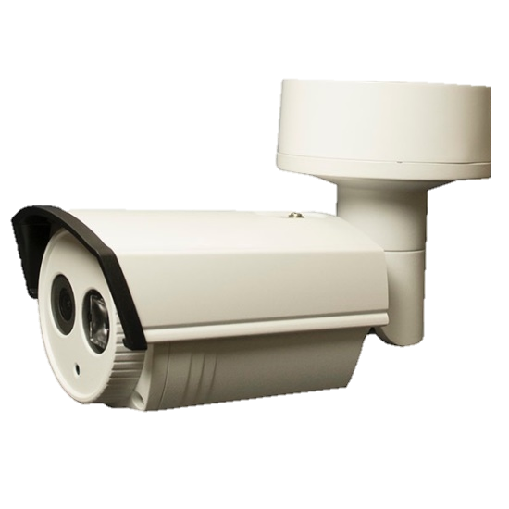

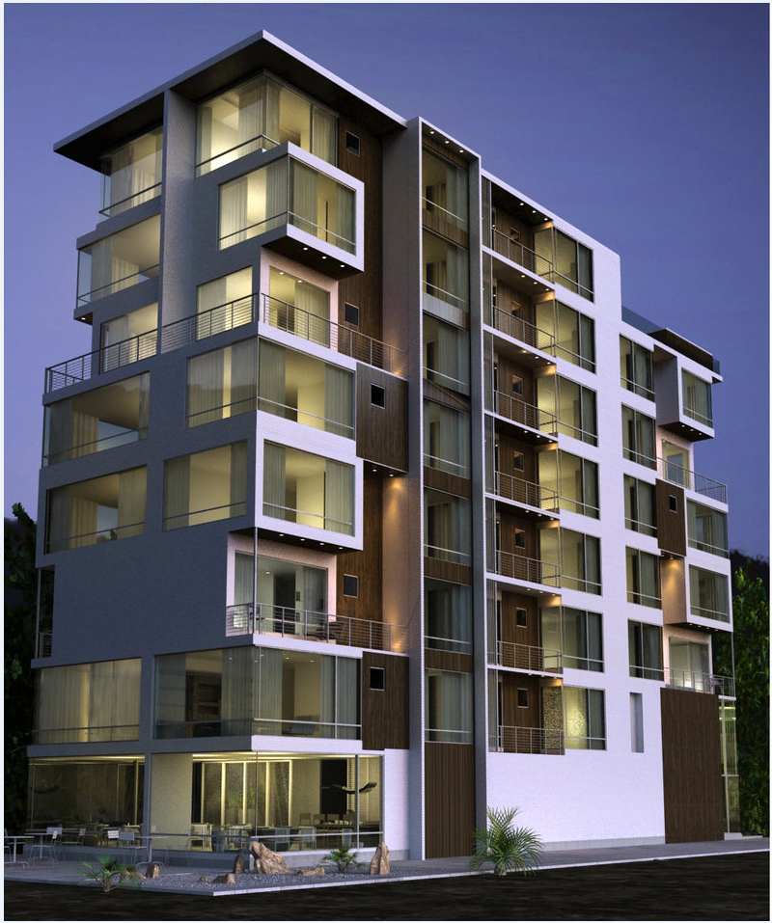
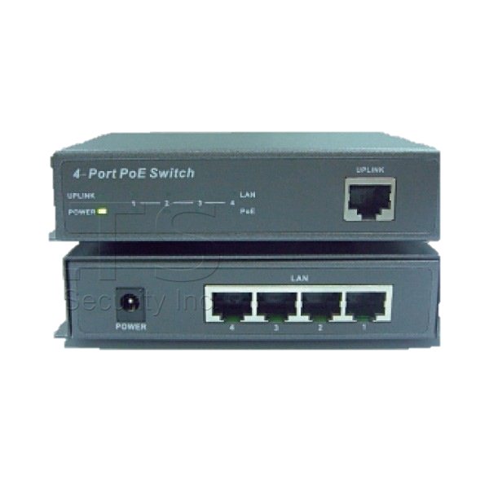
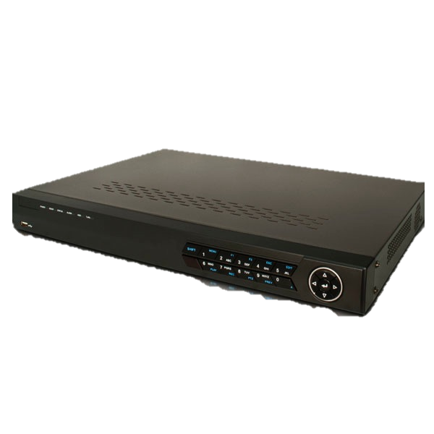
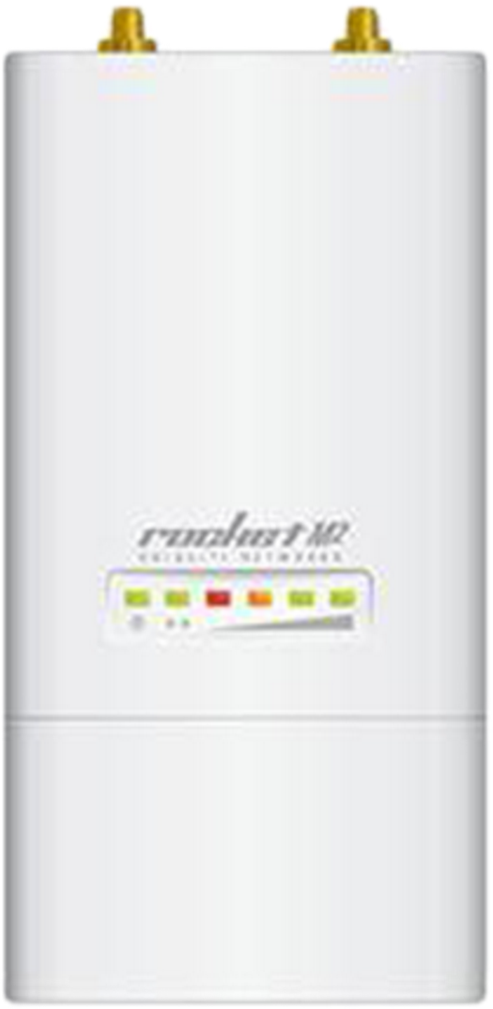
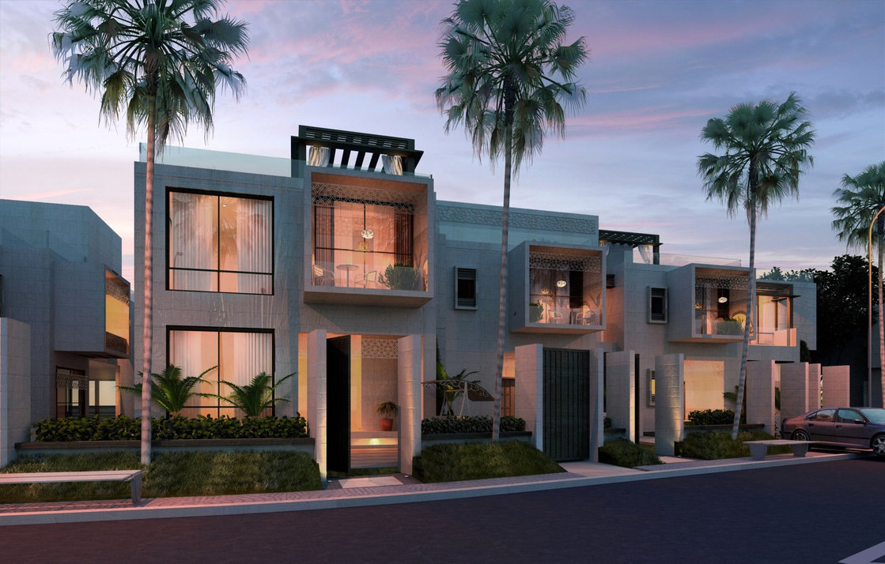
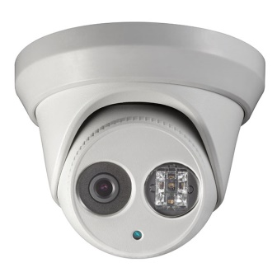
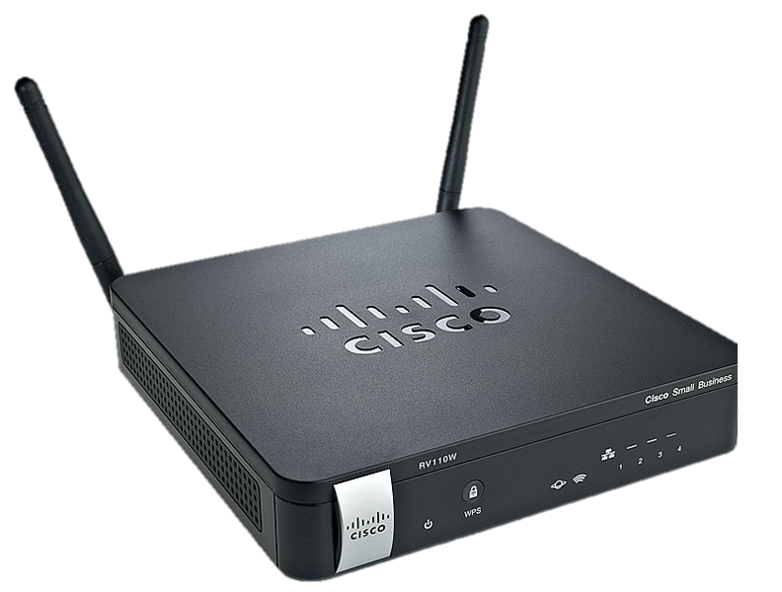
Wireless Set Up for Multiple Buildings
1000ft. away
Transmitter 1
Transmitter 2
1000ft. away
IP Camera
IP Camera
IP Camera
IP Camera
PoE Switch
IP Camera
IP Camera
PoE Switch
Central Hub
NVR
IP Camera
Omnidirectional
Receiver
IP Camera
Router

Slide 14
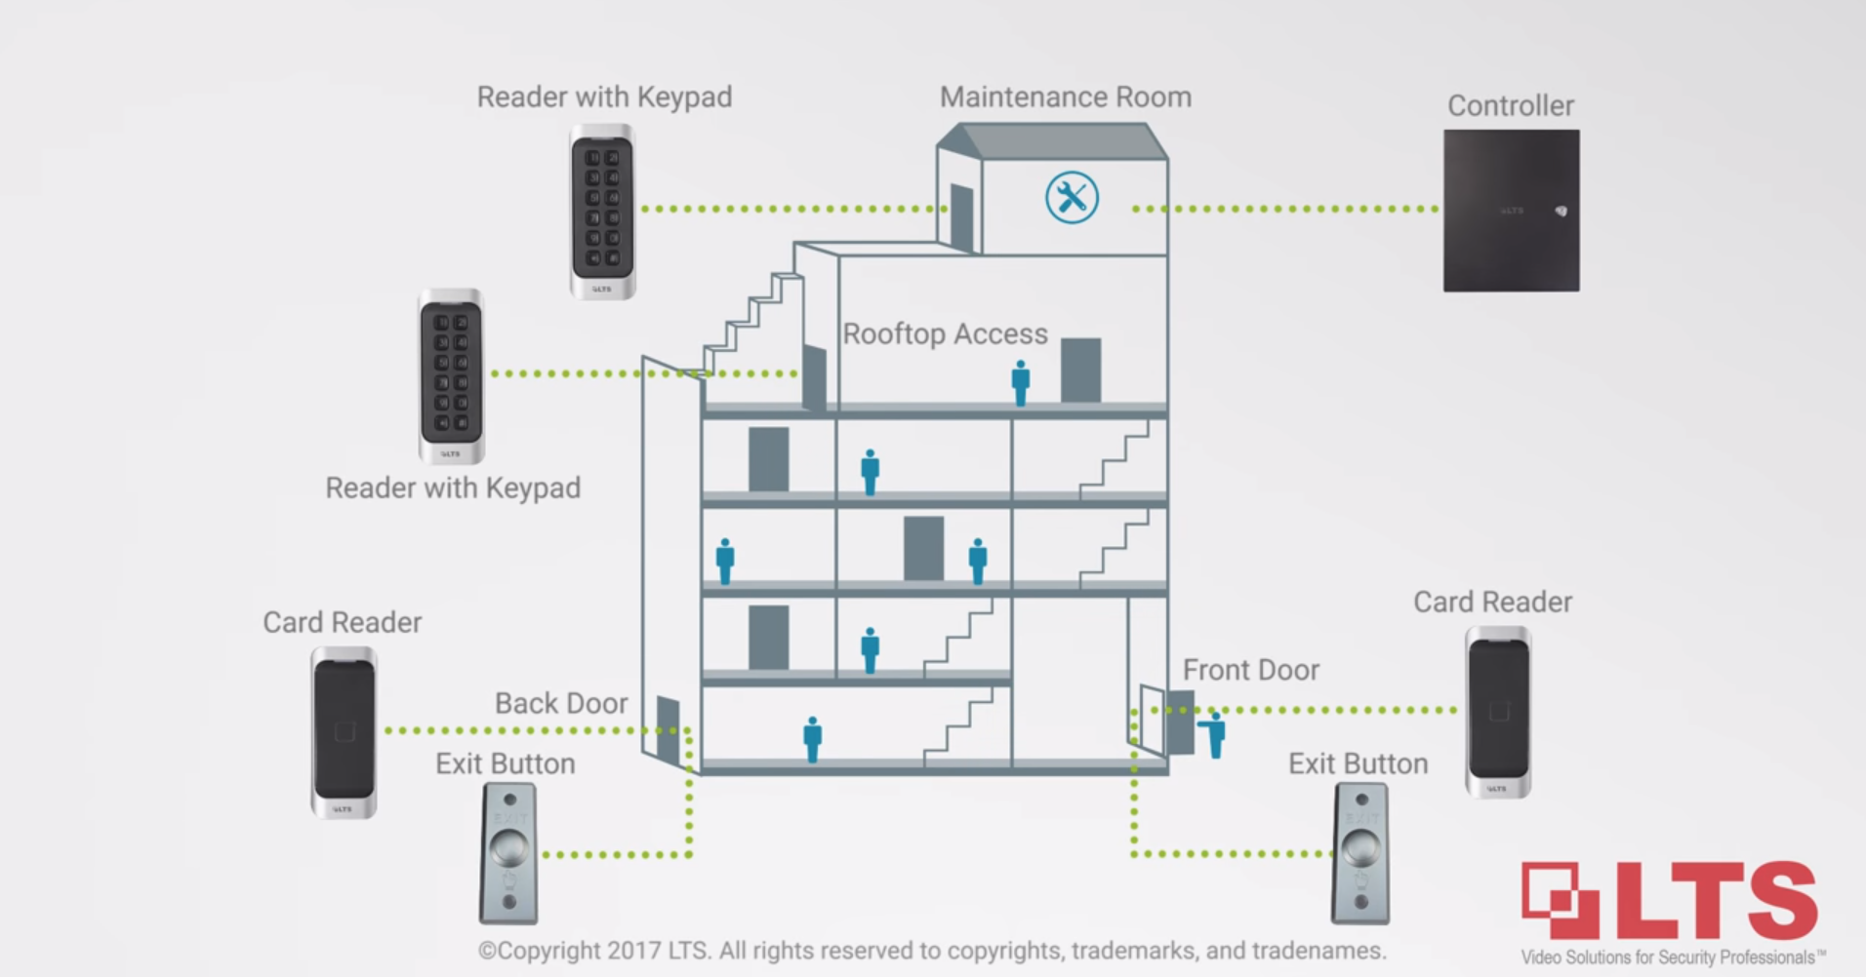
Integrating Cameras with Access Control

Slide 15
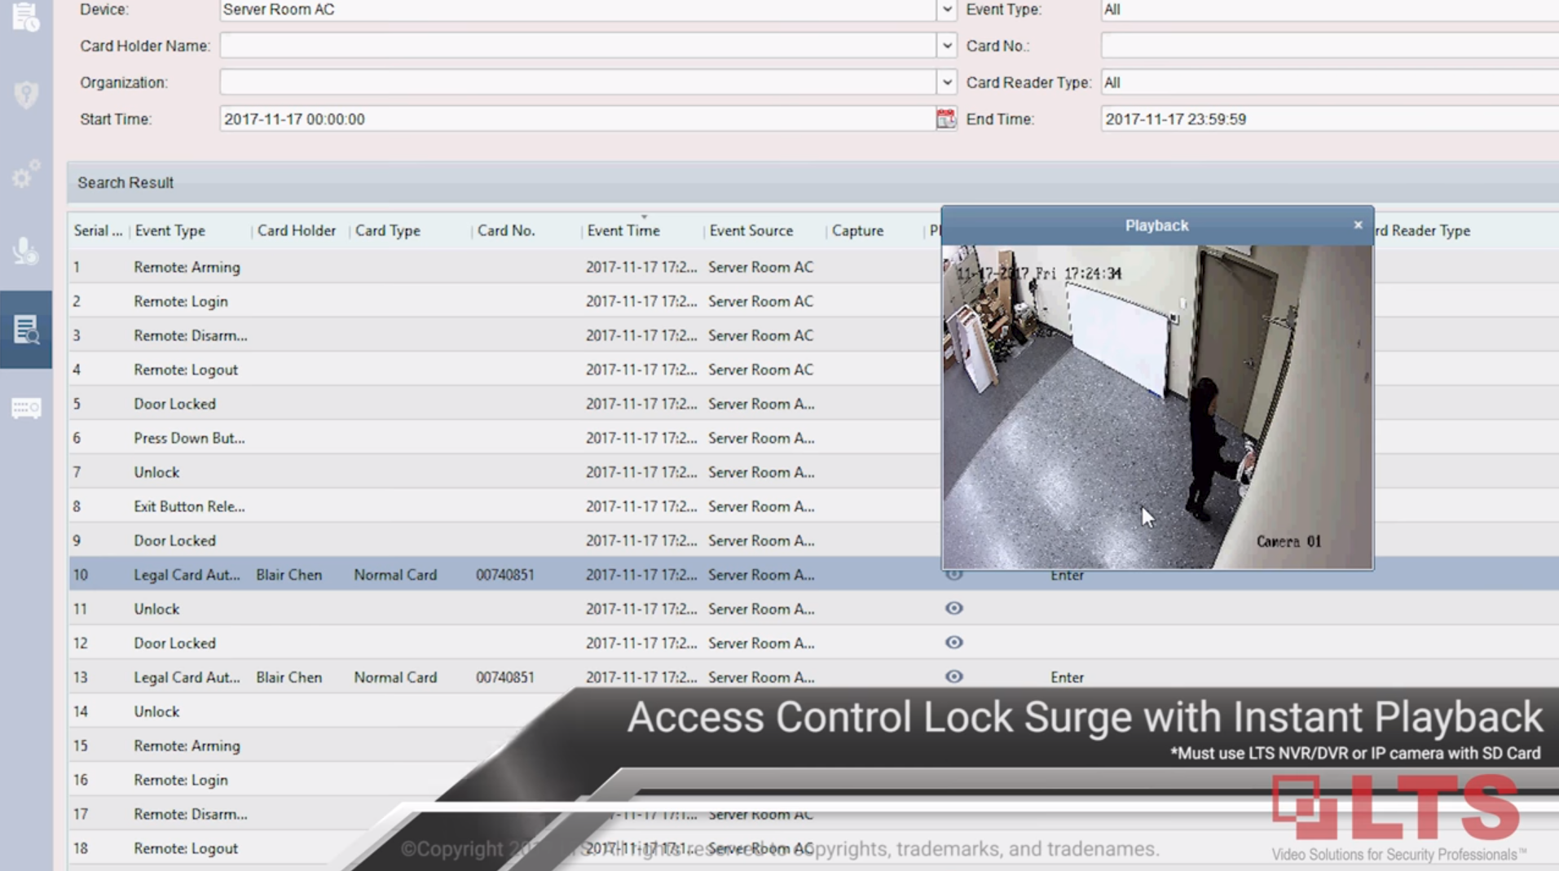
Integrating Cameras with Access Control
– Find Out What’s Going on in a Snap!

Slide 16
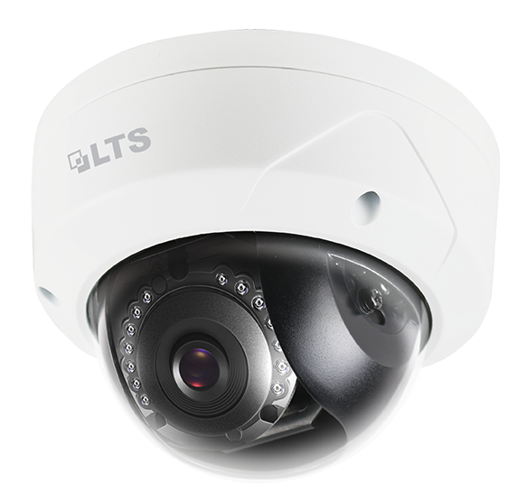
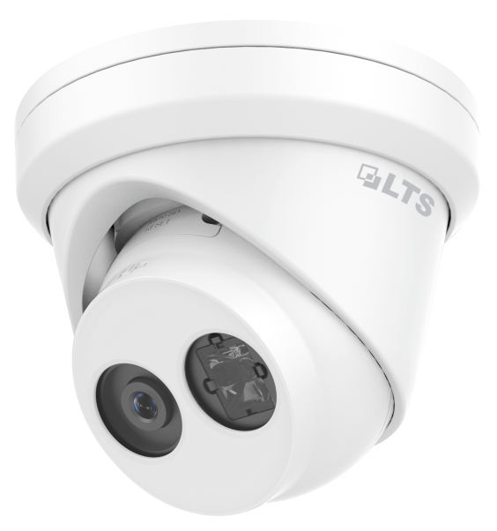
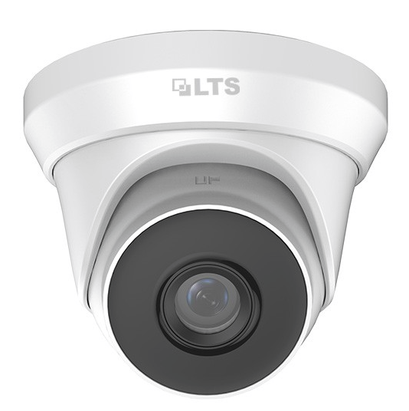
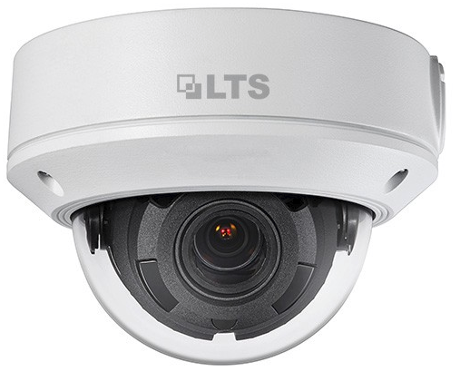
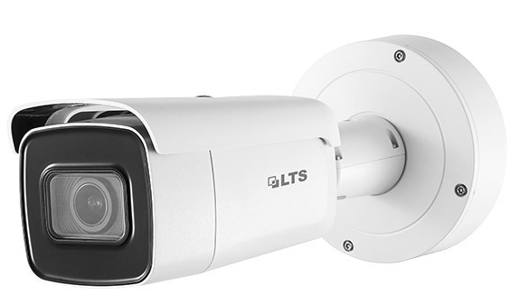
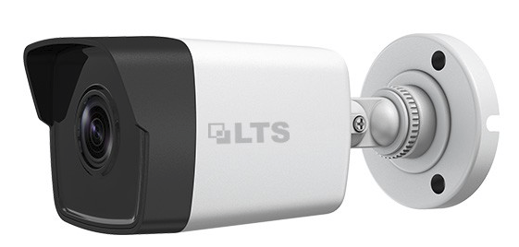
IP Popular Items
• CMIP7422N-28M
• CMIP1042-28
• CMIP8042-28
• CMIP3362W-28M
• CMIP7043W-MZ
• CMIP9863W-SZ

Slide 17
Best Seller: CMIP7422N-28M
Price comparable to TVI, but a lot more advantages!
• Full 1080P
• 12 IR up to 70ft
• 2.8mm Fixed Lens
• Special Design for Wide FoV
• Support H.264 Zip+, H.264
• Micro SD/SDHC/SDXC Card Slot up to 128GB • Video Content Analytics
• DWDR
• 3-Axis
• IP67, IK10 Vandal-Proof
• 3D DNR, BLC
• DC 12V, PoE
• UL Listed
Easier Installation – Just 1 Cable!
Can Standalone
Back Up Footage

Slide 18
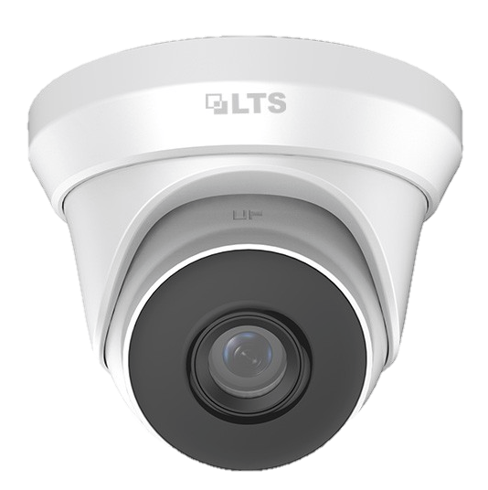
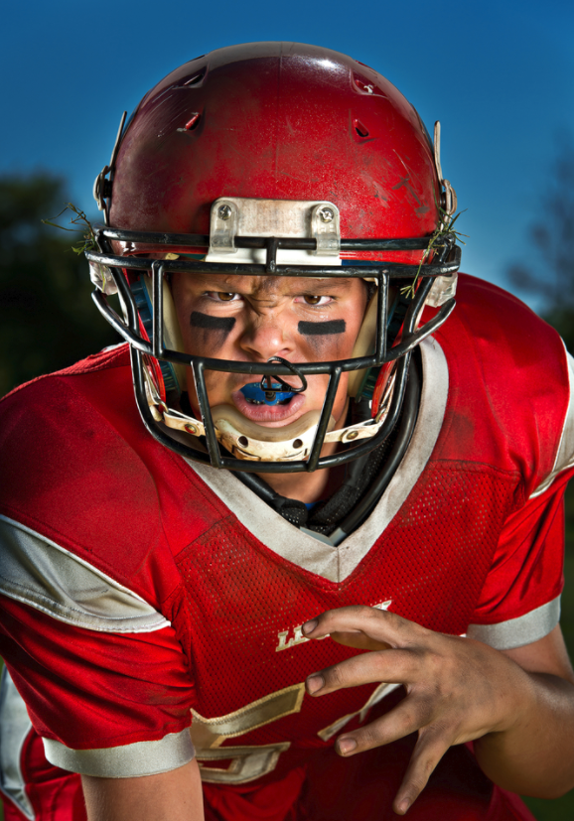
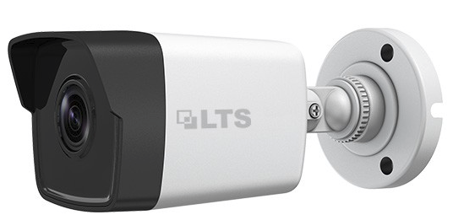
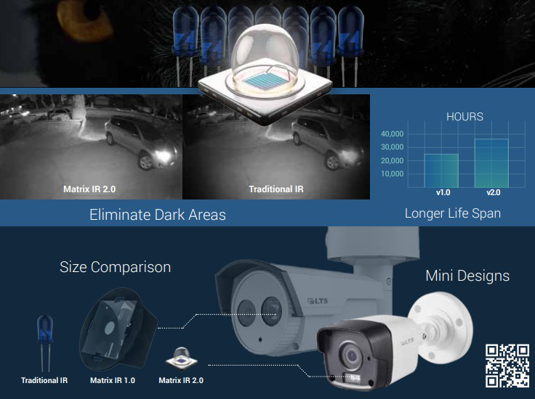
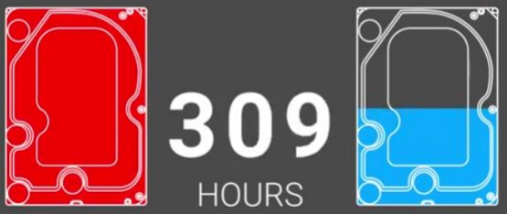
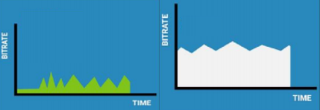
Best Seller: CMIP1042-28
Eye black is a grease or strip applied under the eyes to reduce glare. It is often used by American football, baseball, and lacrosse players to mitigate the effects of bright sunlight or stadium floodlights.
& CMIP8042-28
• 4MP High Res
• Matrix 2.0
• IR LED up to 100ft
• IP67
• DWDR
• 3D DNR, BLC
• Advanced Compression H.265/ H.265+

Slide 19
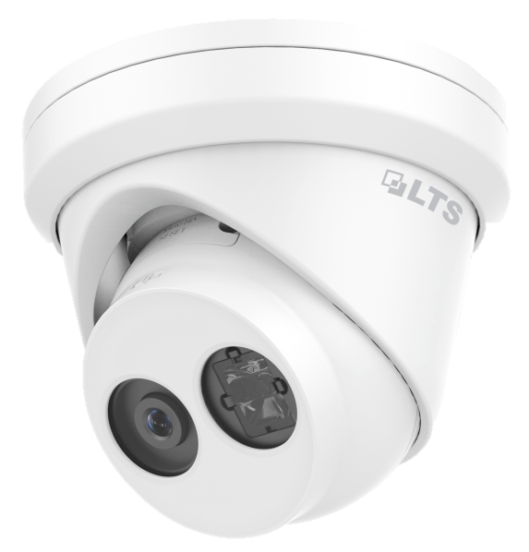
Best Seller: CMIP3362W-28M
6MP High Resolution
at the Price of 4MP Market Price!!
New Improved Easy
Installation Housing
ALL METAL!
• 2.8mm Fixed Lens
• Matrix IR 2.0 LED up to 100ft
• H.265 / H.265+
• Micro SD/SDHC/SDXC Card Slot up to 128GB
• ANR (Automatic Network Replenishment)
• True WDR 120dB
• Video Content Analytics
• IP67
• 3D DNR, BLC
• DC 12V, PoE, UL Listed

Slide 20
Best Seller: CMIP7043W-MZ
Eye black is a grease or strip applied under the eyes to reduce glare. It is often used by American football, baseball, and lacrosse players to mitigate the effects of bright sunlight or stadium floodlights.
• Matrix 2.0
• Advanced Compression H.265/ H.265+
• IR LED up to 100ft
• IP67
• DWDR
• 3D DNR, BLC

Slide 21
Best Seller: CMIP1042-28
Eye black is a grease or strip applied under the eyes to reduce glare. It is often used by American football, baseball, and lacrosse players to mitigate the effects of bright sunlight or stadium floodlights.
• Matrix 2.0
• Advanced Compression H.265/ H.265+
• IR LED up to 100ft
• IP67
• DWDR
• 3D DNR, BLC

